Slide 1
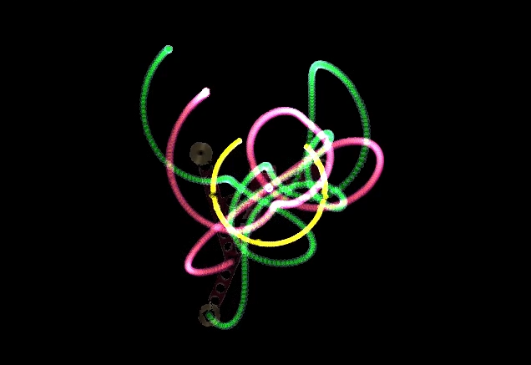
Quantifying Chaos
Angle and mass determinants on the chaotic motion of a triple pendulum.
Murray Jones · Yunki Yau · Riley Jones · Riley Fitzgerald · Adrian Wong

Slide 2
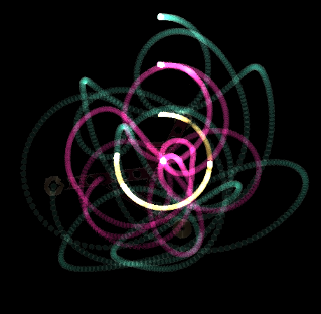
Chaos
“Chaos is when the present determines the future, but the approximate present does not approximately determine the future.”
- Edward Lorenz

Slide 3
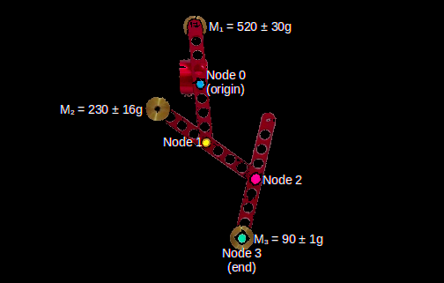
Aim & Hypothesis
To quantify the chaos of a triple pendulum over time, and relate this to the system’s initial conditions.
Angle to vertical (θ)
End node mass (M3)
Chaos ∝ System Energy
Initial Gravitational Potential Energy

Slide 4
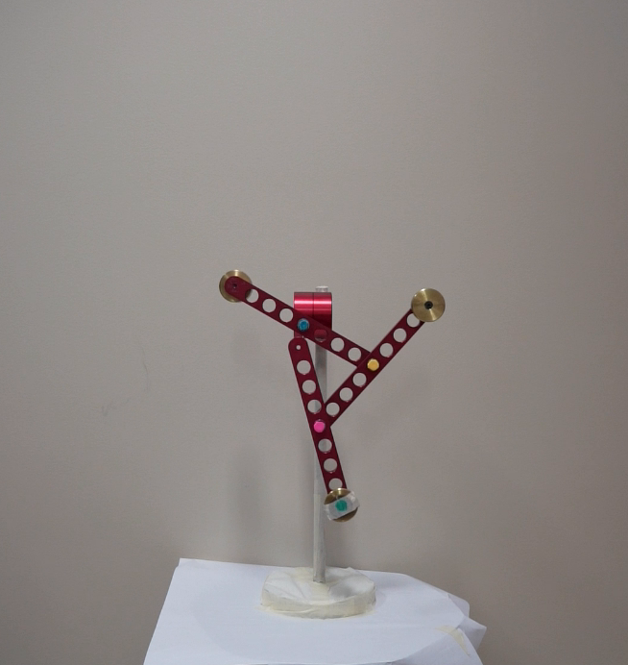
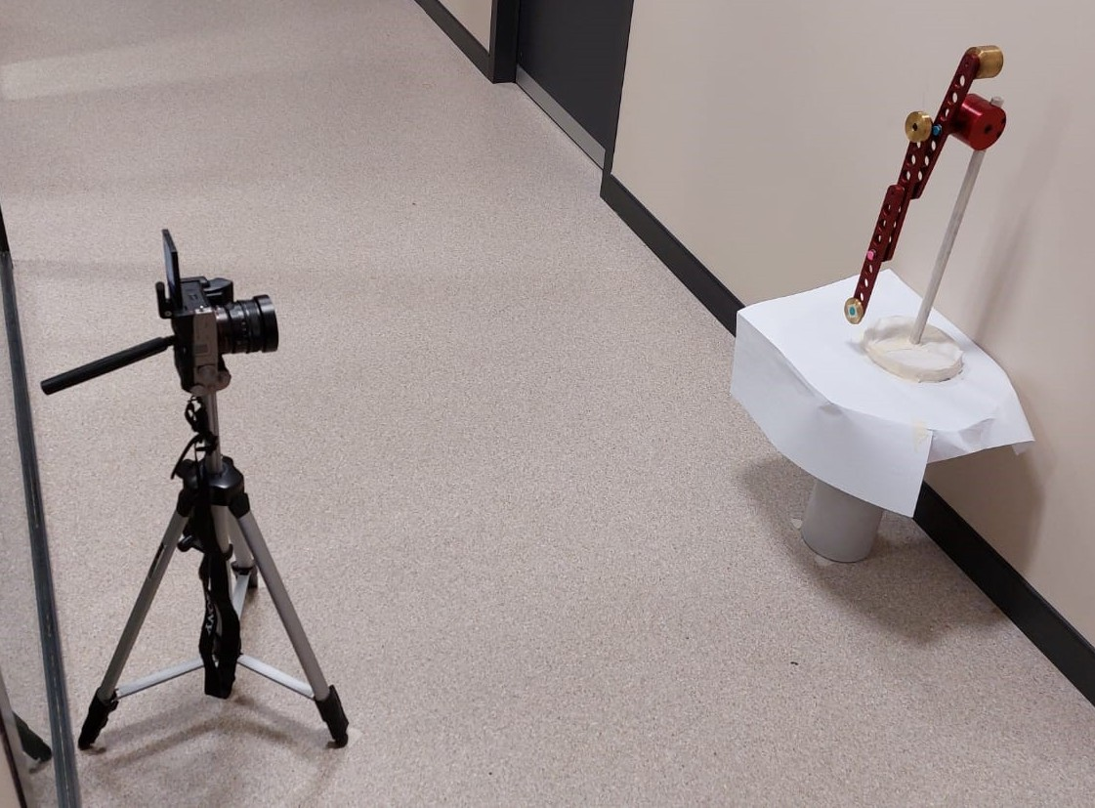
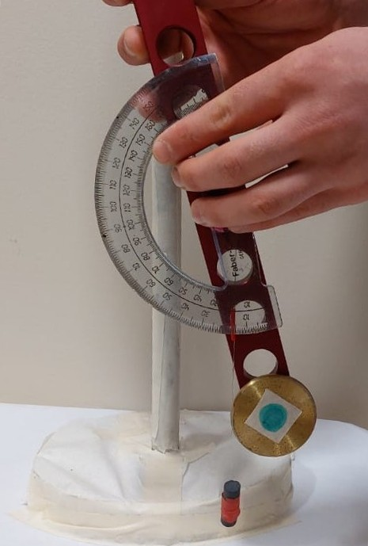
Collecting the Data
③
Three trials for each set of initial conditions.
USYD SoP Triple Pendulum.
1.2m
②
①
Sony A7C Camera, using a 24mm f2.8 lens at aperture f5.6.
Footage recorded at 1080p, 120 FPS.
θ
Paper covering on shiny parts of pendulum.

Slide 5
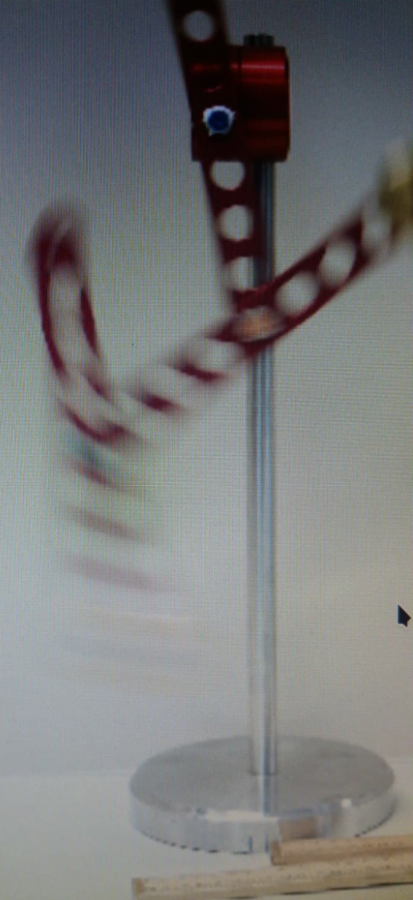
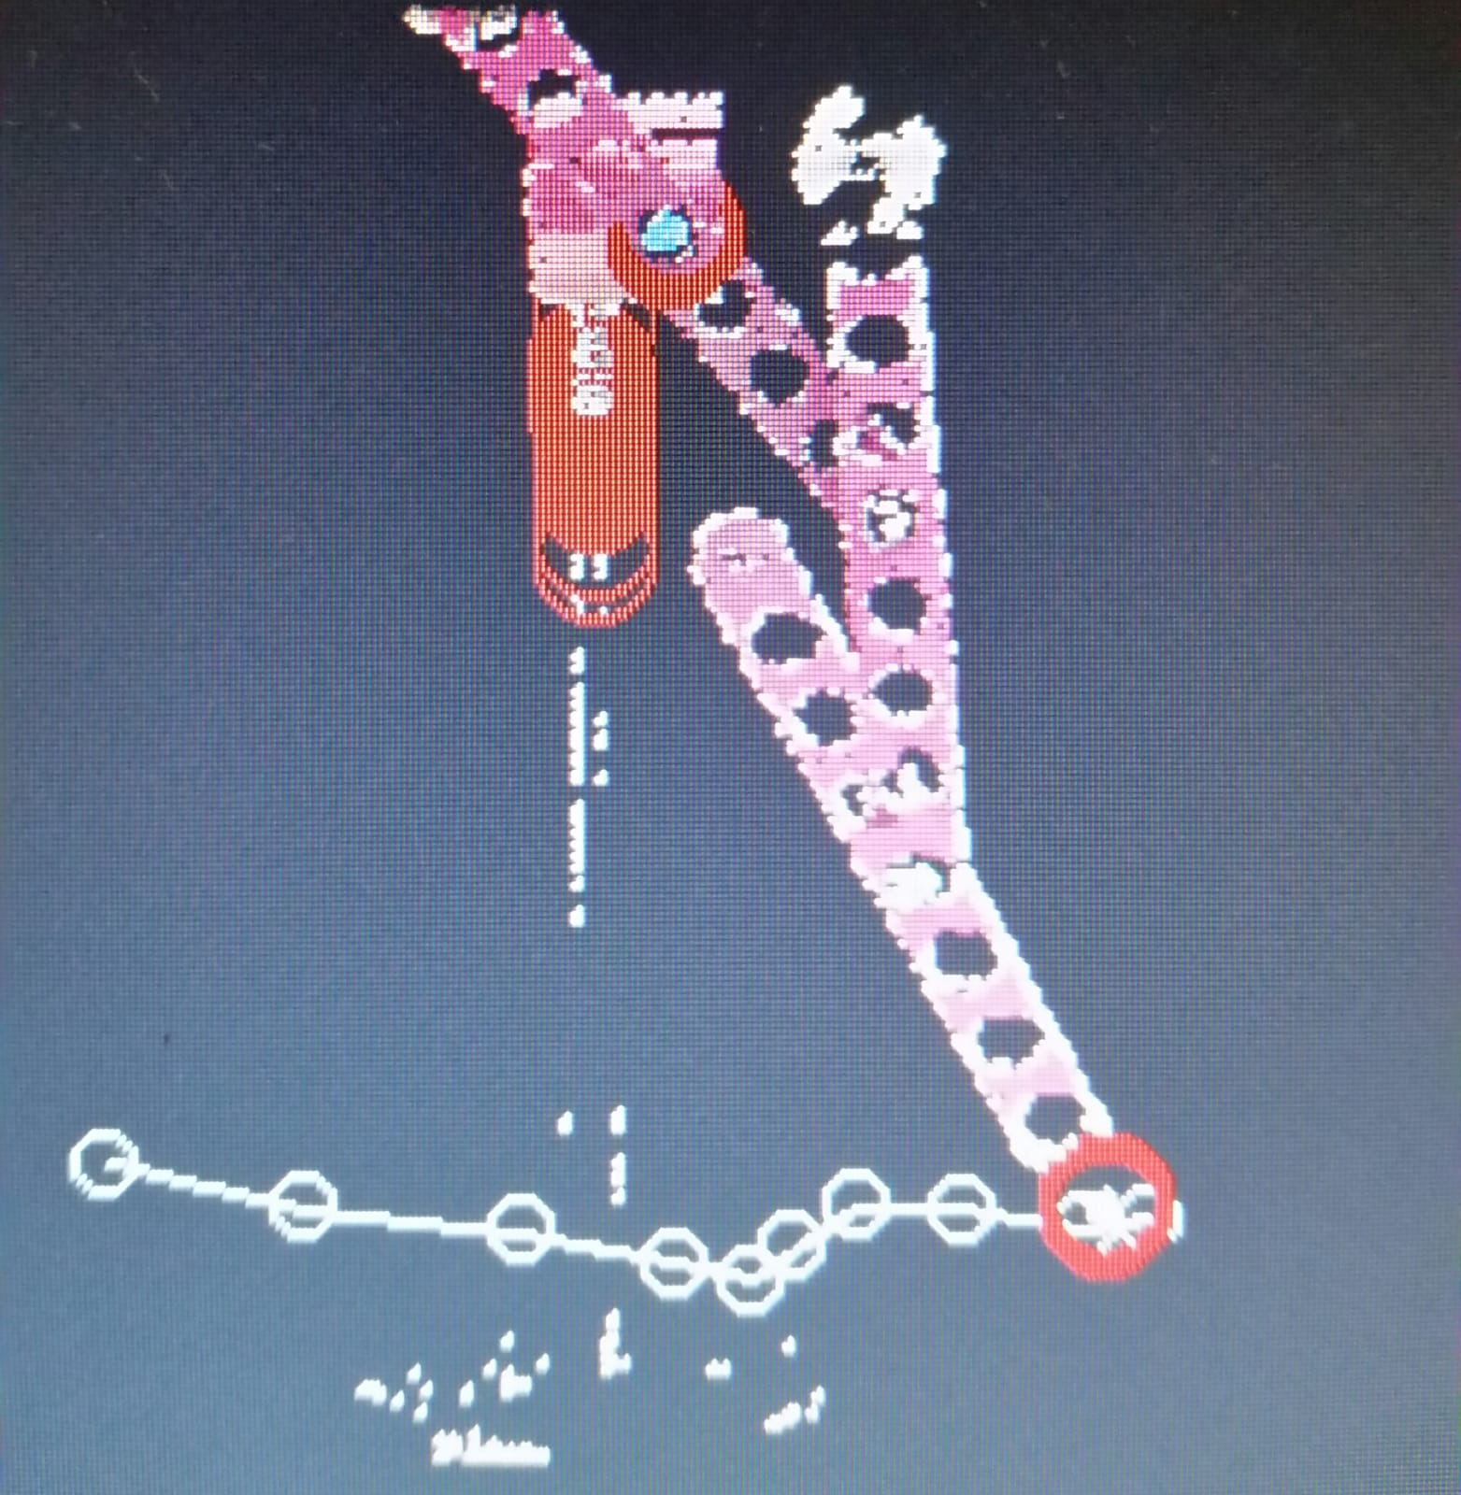
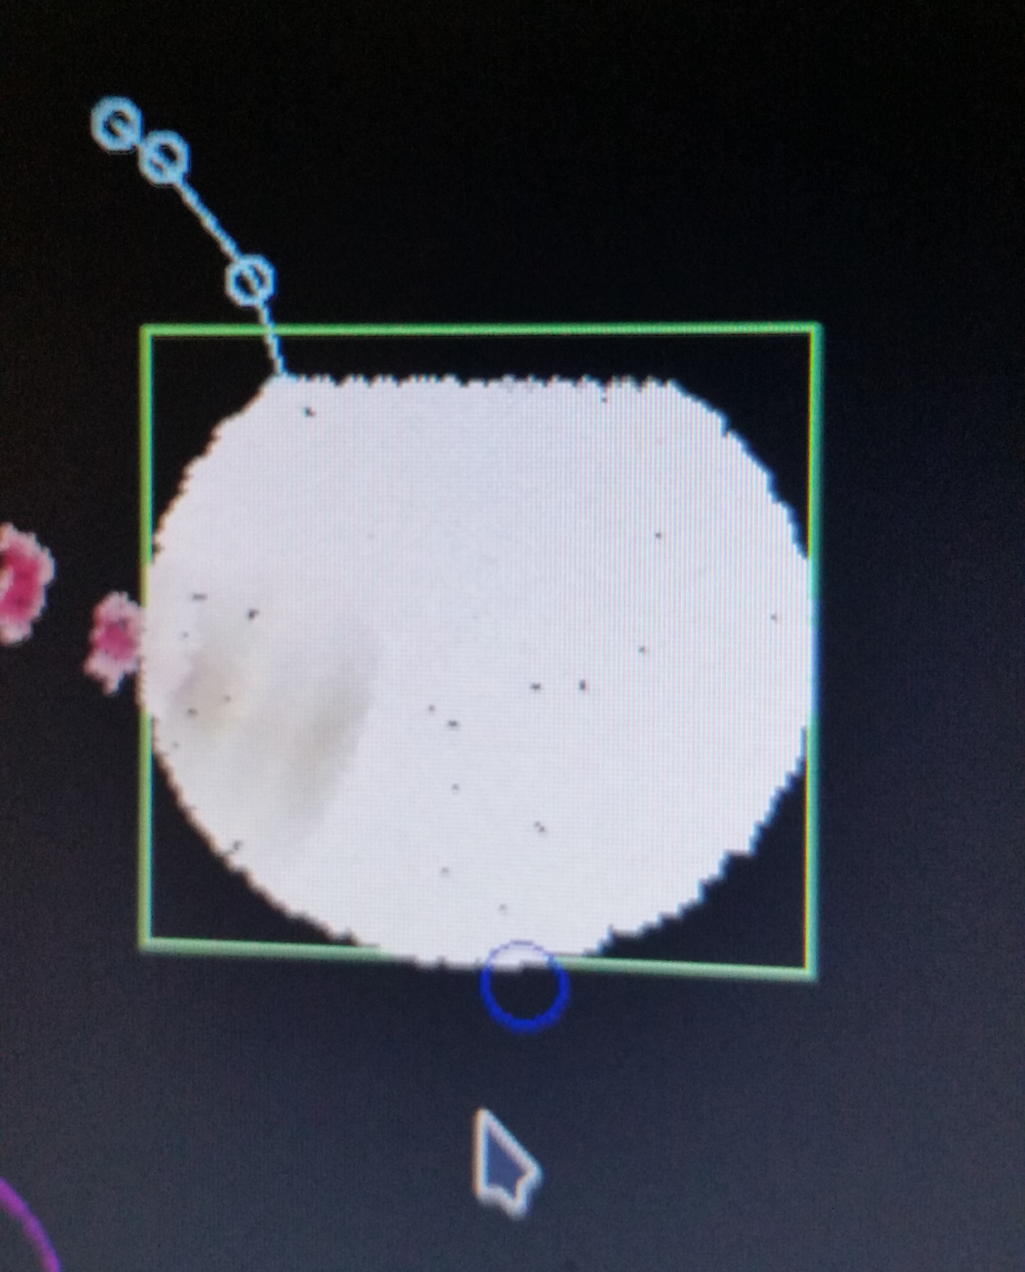
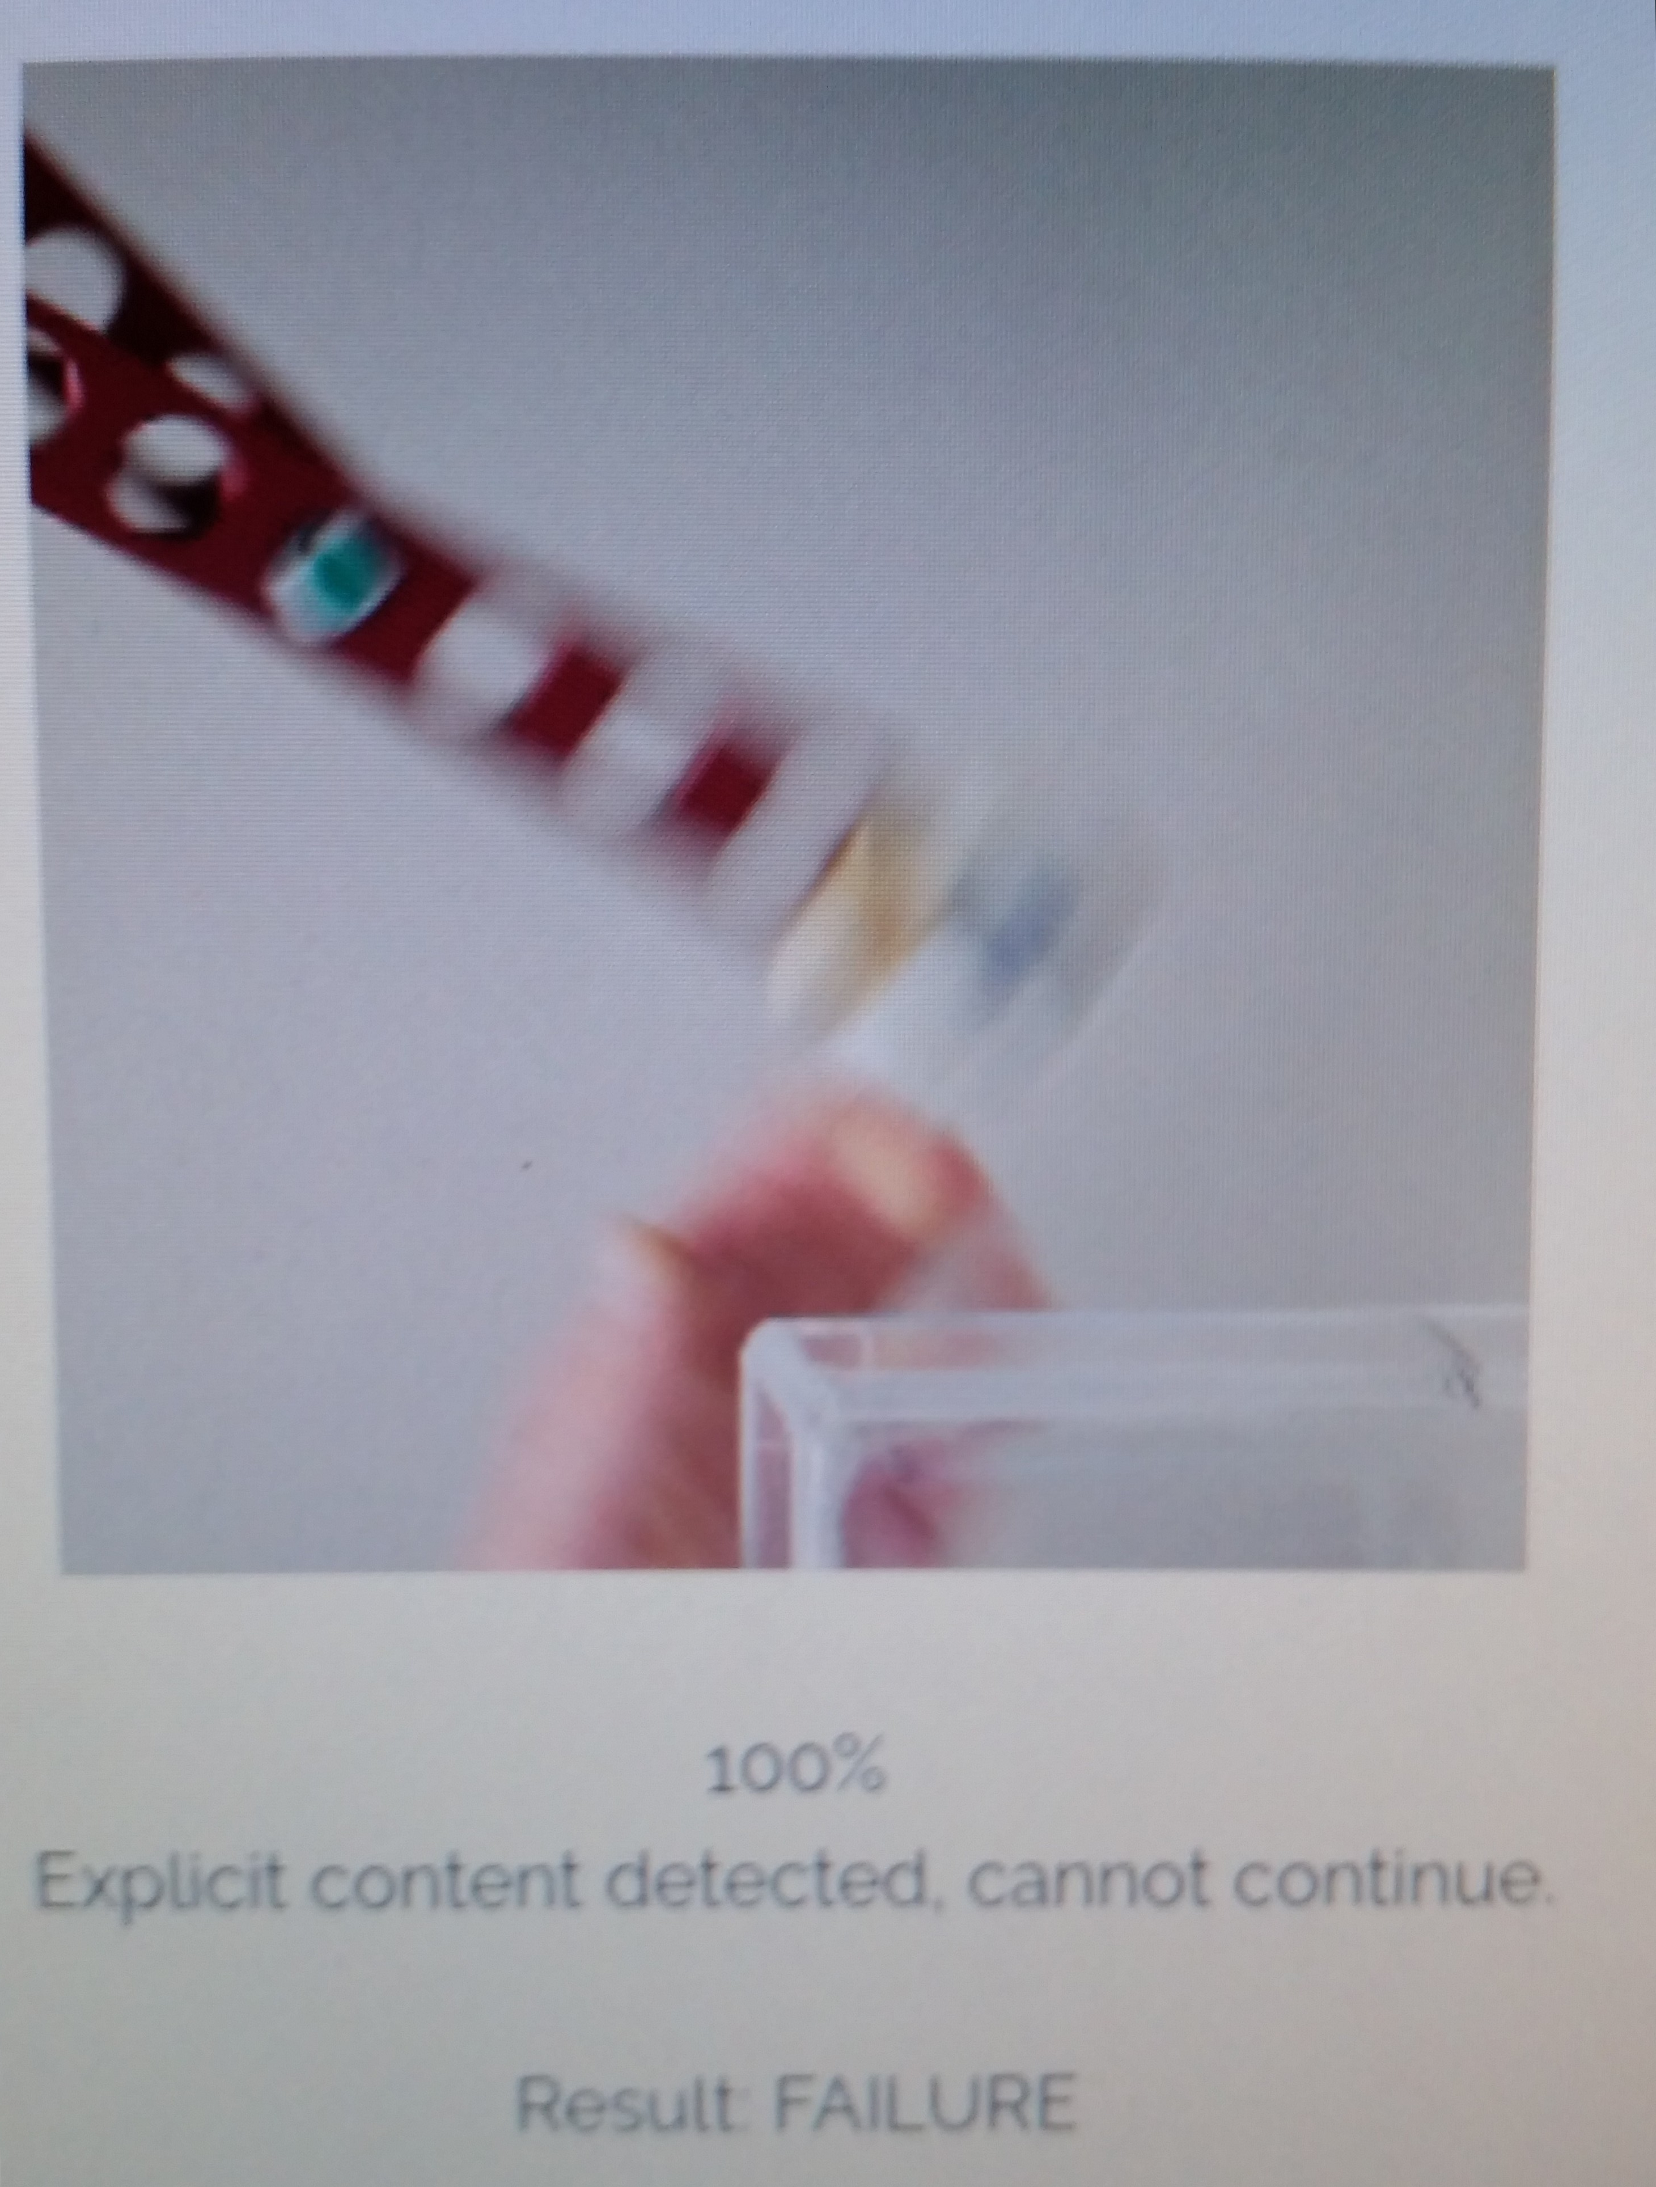
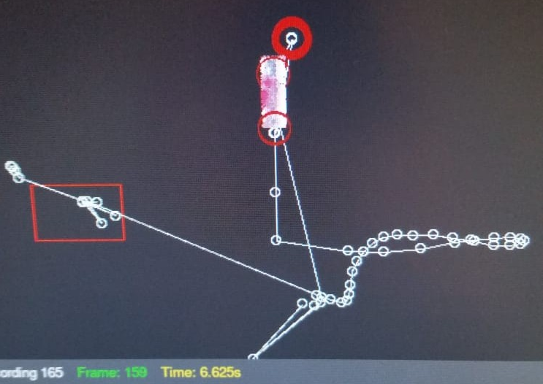
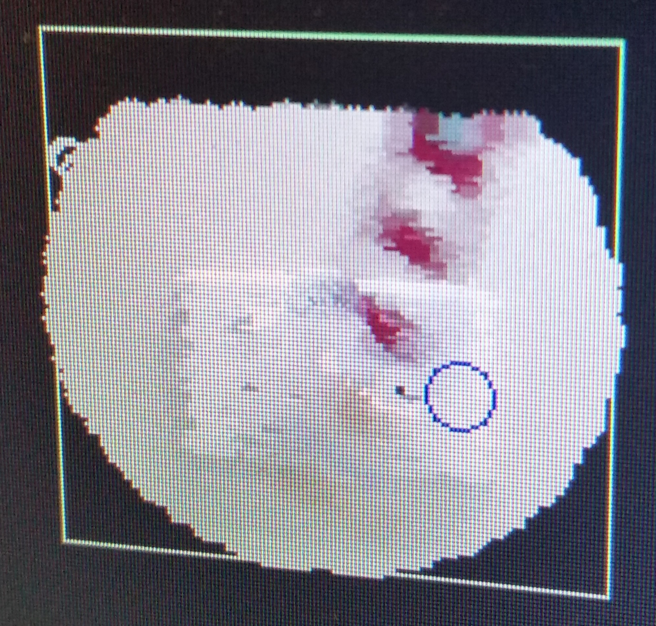
Tracking the Nodes
Dealing with Motion Blur
Can you see any blue in there? I can’t see any blue in there.
Low angle tracking was possible at 24 FPS.
Background objects made things difficult.
Hard to track fast motions.
Online blur removers refused to help.

Slide 6
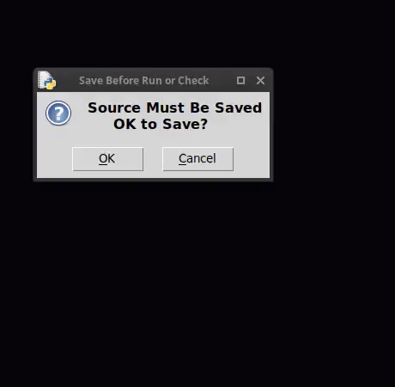
Tracking the Nodes
Retake of data at 120 FPS.
No more blur!
Tracking worked easily using OpenCV + Python.

Slide 7
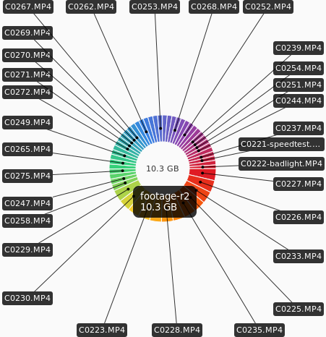
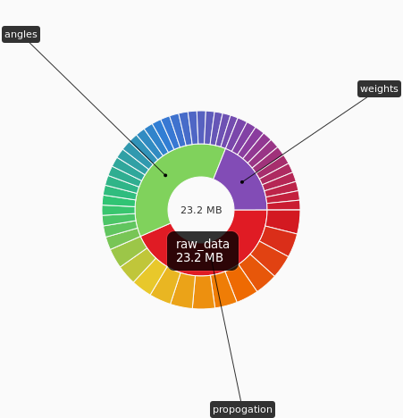
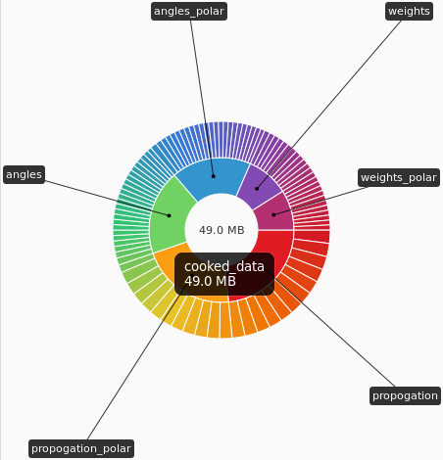

Cleaning the data.
Node tracking.
Rationalise coordinate system +
Interpolation.
Collation + Time correction.

Slide 8
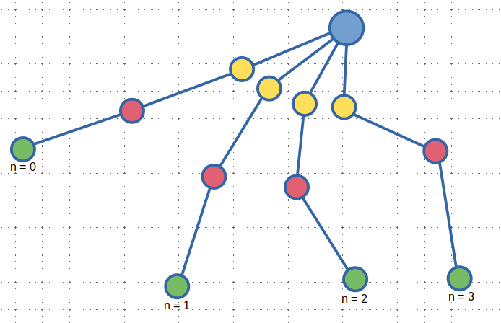
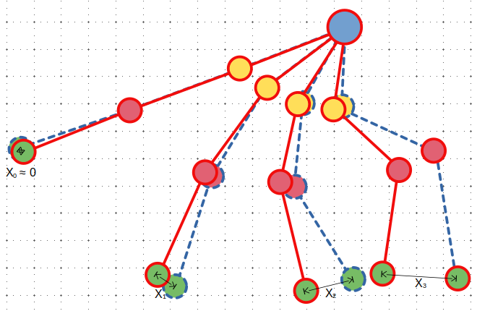
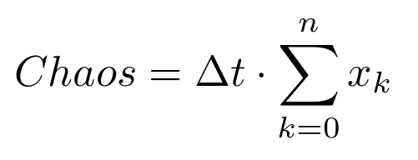
Analysing the Data
Quantifying Chaos
Total number of frames.
Time between each frame.
Distance between end node positions for this frame on different runs with same initial conditions.
Index of current frame.

Slide 9
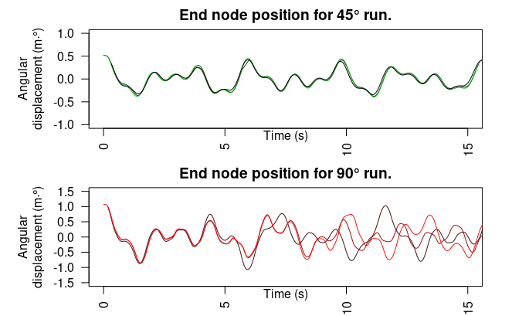
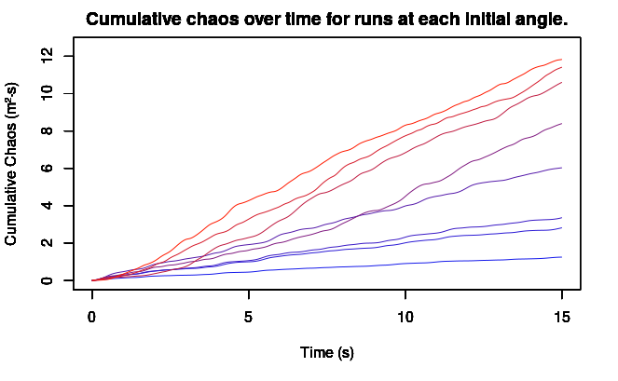
Preliminary Results
Chaotic motion becomes evident.

Slide 10
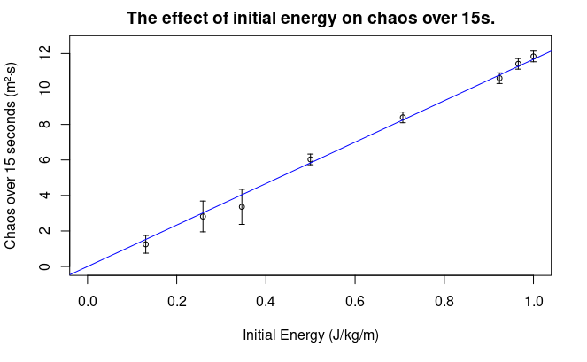
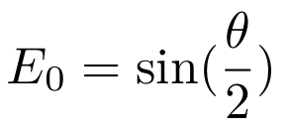
Final Results
R² = 0.998
P Value = 3.03·10⁻¹¹
E0 = 0 at 0°, minimum.
E0 = 1 at 180°, maximum.

Slide 11
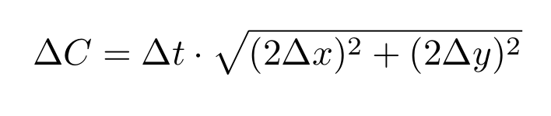
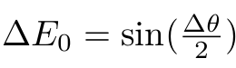
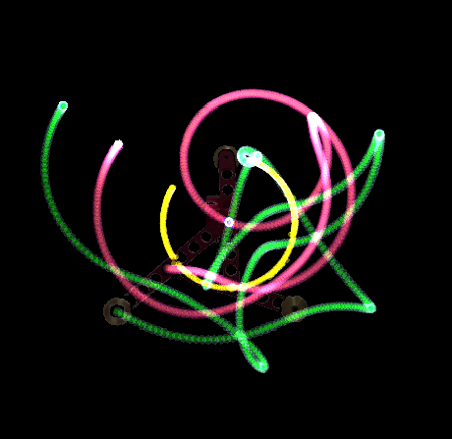
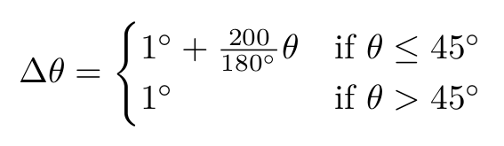
Uncertainties
Uncertainty in quantity of chaos.
Uncertainty in initial energy
Uncertainty in duration of footage ≈̠ 0.008s.
Uncertainty in node coordinates ≪ 1px.
Uncertainty in initial angle.
Uncertainty due to protractor with weird scale (above).
Initial angle.
Standard uncertainty in protractor measurement.

Slide 12
Conclusion & Questions

Slide 13
References.
Levien RB, Tan SM. Double pendulum: An experiment in chaos. American Journal of Physics. 1993;61(11):1038-44.​
Litak G, Borowiec M, Da̧bek K. The Transition to Chaos of Pendulum Systems. Applied Sciences. 2022;12(17):8876.​

